Slide 1

Hulu Data Analysis
IST 687 Fall 2022
Group F
Caitlin Rookey
Ceara Stewart
Kawshif Muhammed
Randy Garcia

Slide 2

Business Questions
What makes a show “popular”? What factors make a show “popular”?
How does show popularity compare to other values within the dataset?
Are there correlations between variables that result in a show being “popular”?

Slide 3
Attribute Categories
ShowID
ShowTime
ShowCanonicalName
ShowEpisodeCount
ShowGenre
ShowSubGenre
ShowName
ShowRating
ShowSeasonsCount
ShowType
ShowCompanyID
ShowCompanyChannelID
ShowCompanyName

Slide 4



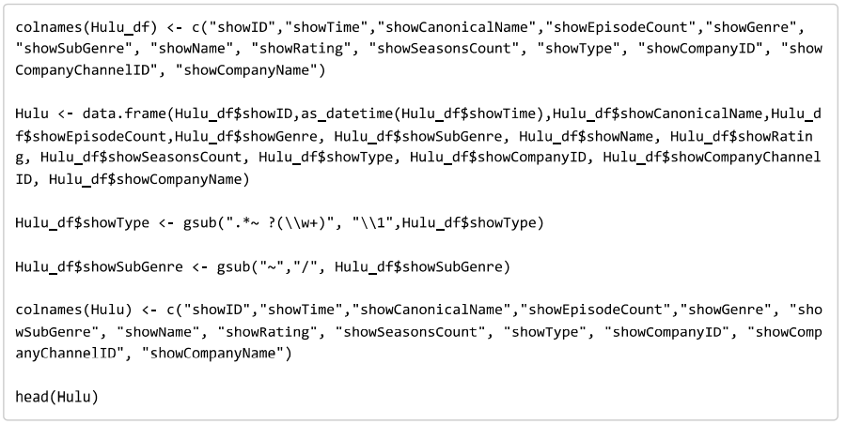
Data Cleaning, Munging and Preparation
Read in the data and linked it to a data frame.
Removed any "un-needed" columns for simplicity.
Renamed our columns.
Removed any unnecessary symbols from columns.

Slide 5
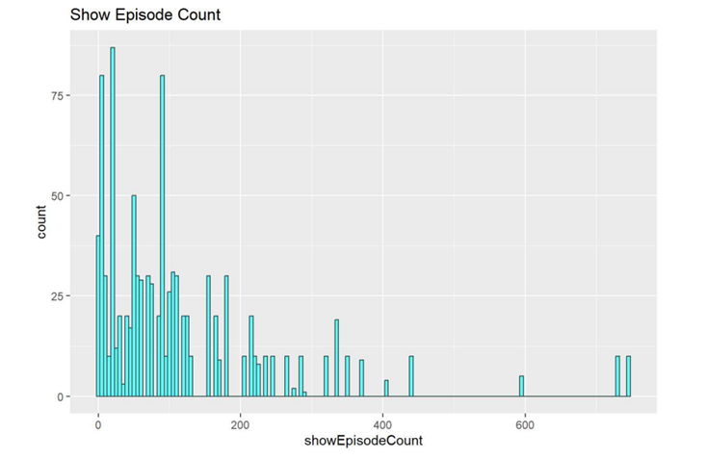
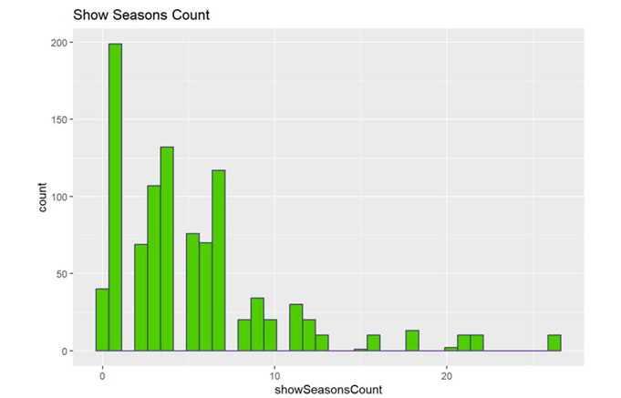
Data: Descriptive Statistics & Visualization
Histograms
Show season count: Histogram of show season count. As seasons increase, episode count increases.
Show episode count: Histogram of episode count. Most shows have lower episode counts

Slide 6
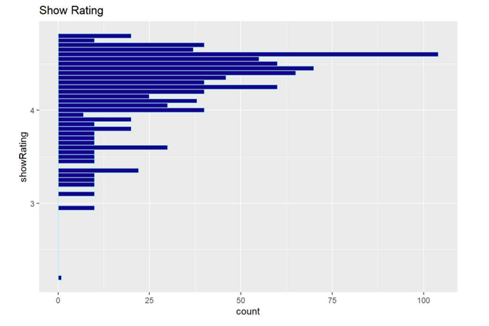
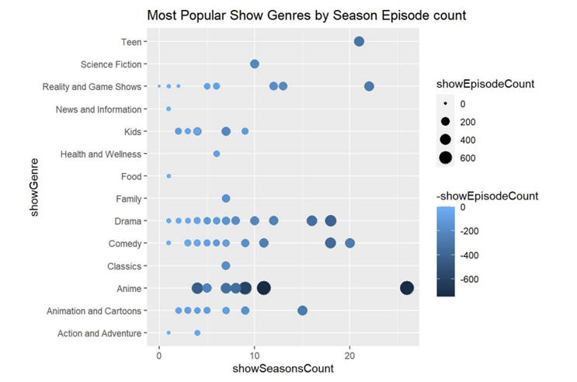
Data: Descriptive Statistics & Visualization
Histogram
Show rating: Histogram of show rating. Most shows have ratings from 3-5, with one show having a rating of 1.
Plot
Season episode count: Histogram of episode count based on shoe season count and show genre. For each genre, we can see that shows with more seasons had more episodes.

Slide 7
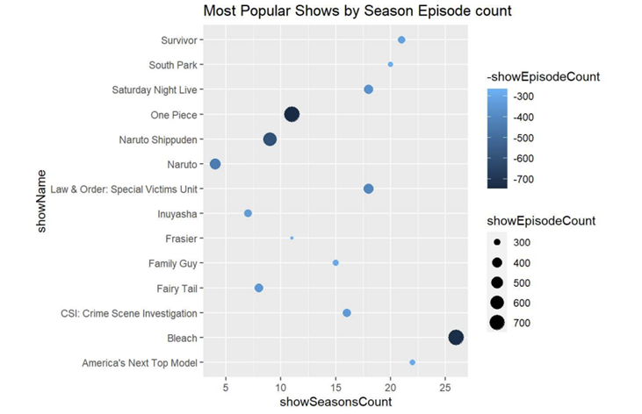
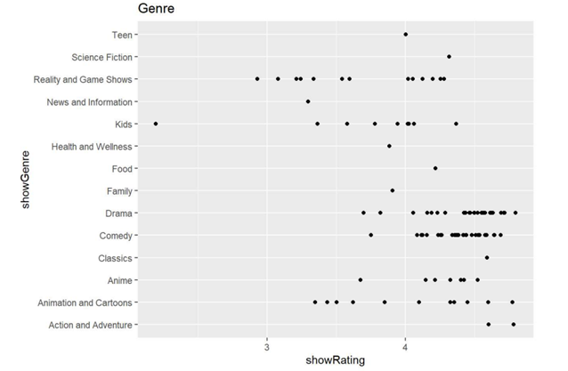
Data: Descriptive Statistics & Visualization
Plot
Season episode count 2: Histogram of episode count based on shoe season count and show genre where episode count is greater than 250. Compared to the last plot, the data has no real pattern.
Show genre vs show rating: A plot showing us shows, within their respective genres, who received the highest show ratings.

Slide 8
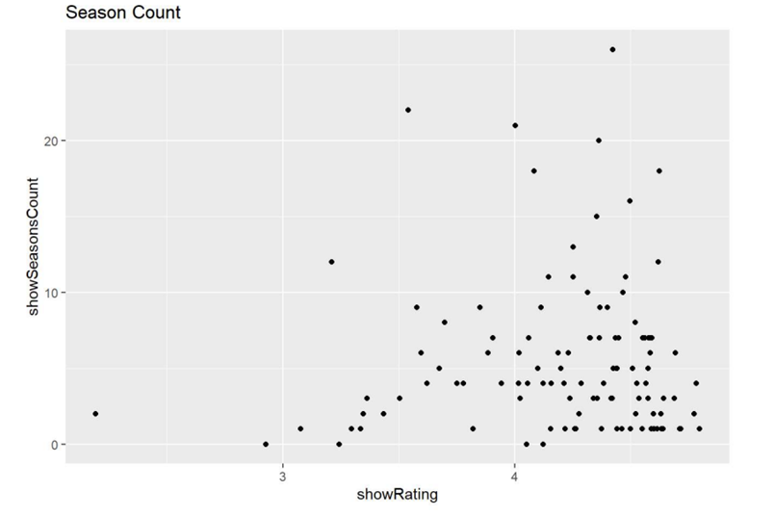
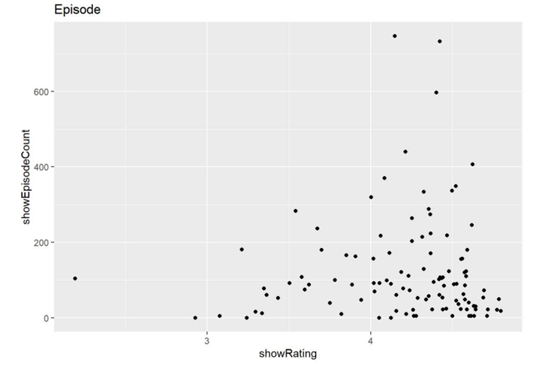
Data: Descriptive Statistics & Visualization
Plot
Show episode count vs show rating: Plot showing what episode counts have the highest show ratings.
Show season count vs show rating: Plot showing what shows have the highest show rating based on season count.

Slide 9
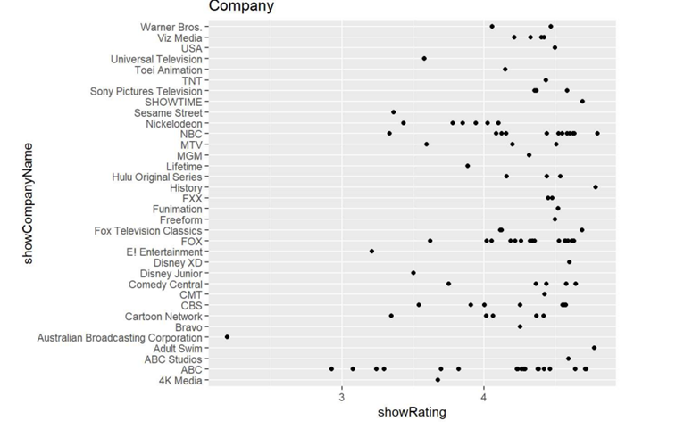
Data: Descriptive Statistics & Visualization
Plot
Show episode count vs show rating: Plot showing what episode counts have the highest show ratings.
Show season count vs show rating: Plot showing what shows have the highest show rating based on season count.
Show company vs show rating: A plot showing us highest show ratings based on the company those shows belong to.

Slide 10
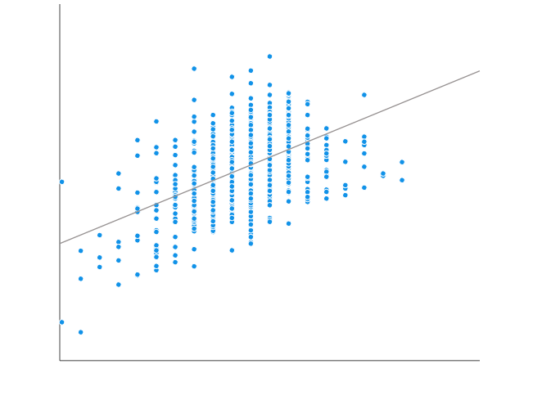
Data: Modeling
Linear Regression Model
We compiled 7 models to look at what variables affect show rating. Throughout the models we keep show rating as our y-variable and define different x-variables for each model. We then look at the R² and adjusted R² of each model to determine what independent variables are statistically significant when it comes to their effect on show rating.

Slide 11
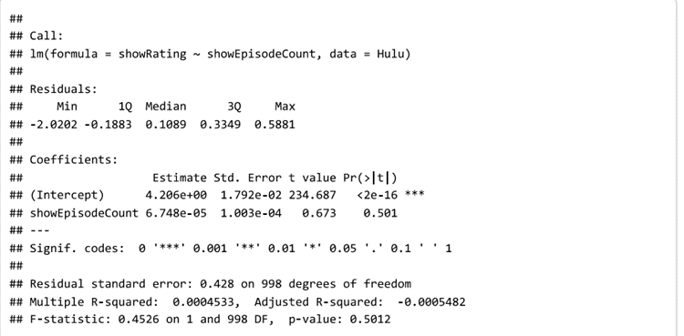
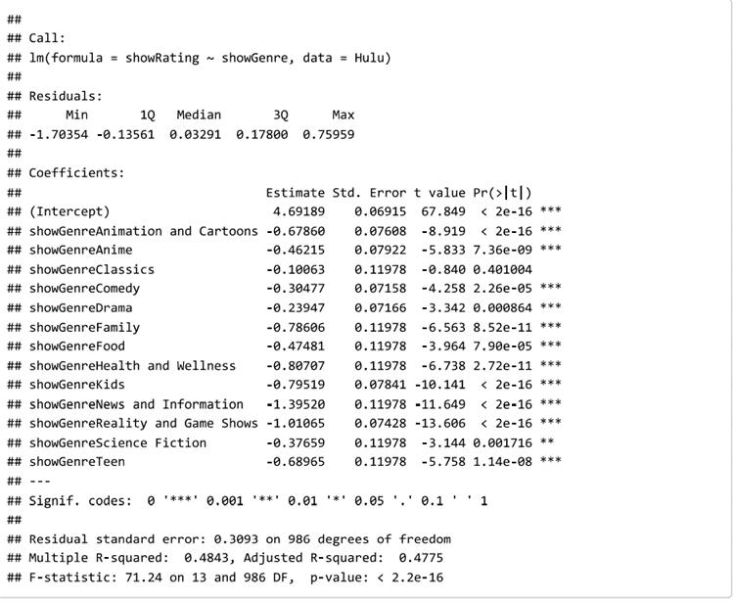
Data: Modeling
Model 1 - Show ratings vs episode count: We got an R² of 0.0004533 and adjusted R² of -0.0005482.
Model 2 - Show ratings vs show genre: We got an R² of 0.4843 and adjusted R² of 0.4665. And various genre types such as showGenreClassics and showGenreScience Fiction are less statistically significant than other aspects within show genre.

Slide 12
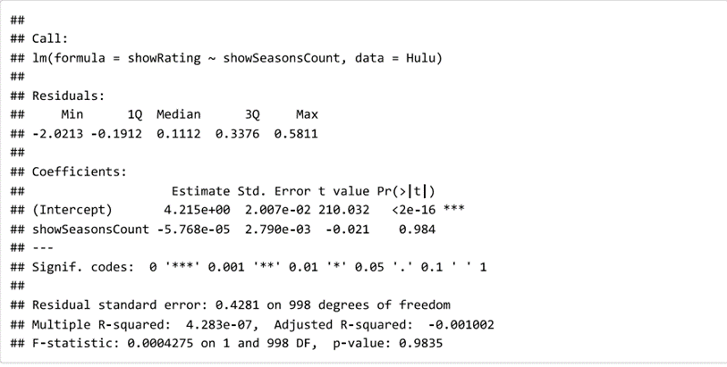
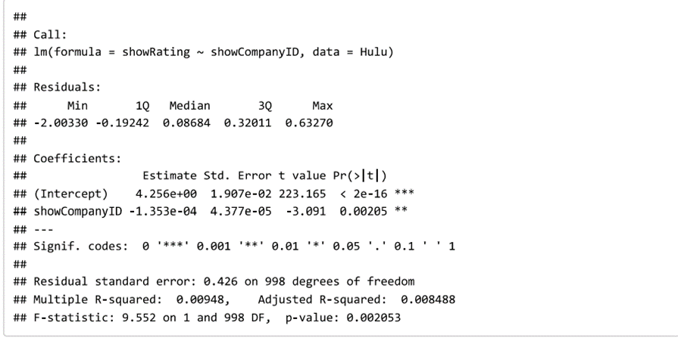
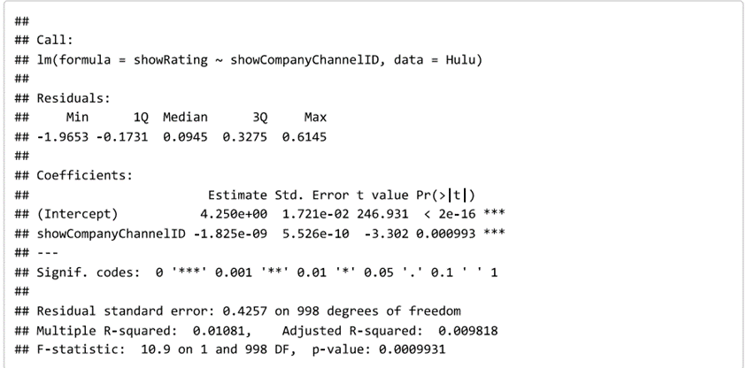
Data: Modeling
Model 3 - Show ratings vs show season count. We get an R² of 4.283e-07 and adjusted R² of -0.001002.
Model 4 - Show ratings vs show company id: This model produces an R² of 0.00948 and adjusted R² of 0.008488.
Model 5 - show ratings vs show company channel id: The R² and adjusted R² values of 0.01081 and 0.009818.

Slide 13
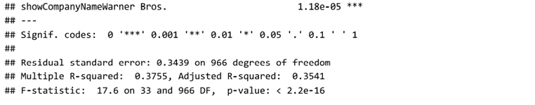
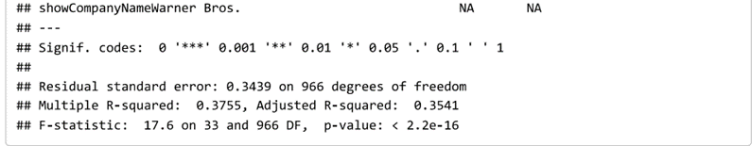
Data: Modeling
Model 6 – show rating vs show company name: We got an R² of 0.3755 and adjusted R² of 0.3541. And various show company names such as showCompanyNameMTV and showCompanyNameABC are among some of the more statistically significant companies .
Model 7 - show rating vs show company id, show company channel id and shoe company name: This is our multiple regression model and it produces an R² of 0.3755 and adjusted R² of 0.3541. We can also look at the combined aspects of the variables to see that showCompanyNameHulu Original Series and showCompanyNameAdult Swim are among some of the more statistically significant columns within our variables.

Slide 14
Actionable Insights
Based on the models we ran, the following factors have the greatest influence on show ratings on Hulu:
Show company name
Show company ID
Show genre
Show company channel
If Hulu decided to place all their shows on the most statistically significant companies and channels, theoretically, they could increase the rating of all their shows.
If Hulu choose to focus on only streaming shows that belonged to their most statistically significant genres, they could theoretically increase their average show rating.

Slide 15
Actionable Insights
Based on our linear regression models, such subsets as showCompanyNameHulu Original Series and showCompanyNameAdult Swim are among show companies that result in the highest show ratings.
showGenreClassics and showGenreScience Fiction result in the worst ratings among genres that Hulu streams.
Overall, our models tell us that what companies, channels and genres have the most overall effect on show rating, no matter what other variables are within our model.

Slide 16

Any Questions?
Thank You
z

